Slide 1
Enemy Pie Book Report by First and Last Name
Author: Derek Munson
Illustrated by: Tara Calahan

Slide 2
The Main Characters
Jeremy Ross
The boy
His dad

Slide 3
The Setting
The neighborhood

Slide 4
Summary
A new kid moved to the neighborhood named Jeremy Ross. The main character became jealous because Jeremy was popular and took all of his friends. Jeremy became his enemy. The boy decided he would make Enemy Pie to hurt his enemy but he became friends with Jeremy. He shared Enemy Pie with Jeremy but it turns out that Enemy Pie makes friends instead of enemies.

Slide 5
My Favorite Part
When they became good friends

Slide 6
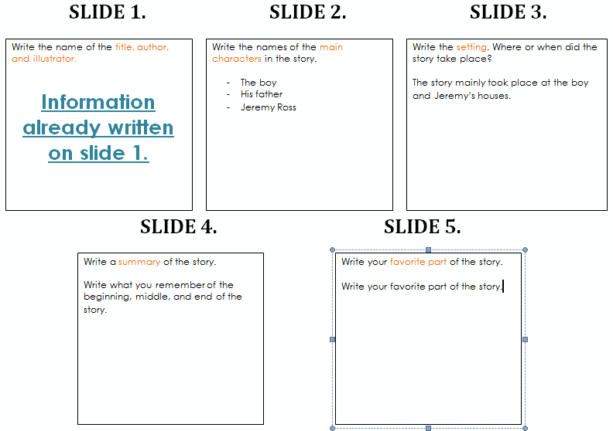
Use these notes for help if needed,

